Slide 1
Geographic patterns of living tetrapod diversity reveal the signature of global diversification dynamics
Jiří Šmíd
Iris Menéndez Elizabeth Steell
Guillermo Navalón Fernando Blanco
Hector Tejero-Cicuéndez
JŠ:
PřF UK
Národní muzeum

Slide 2
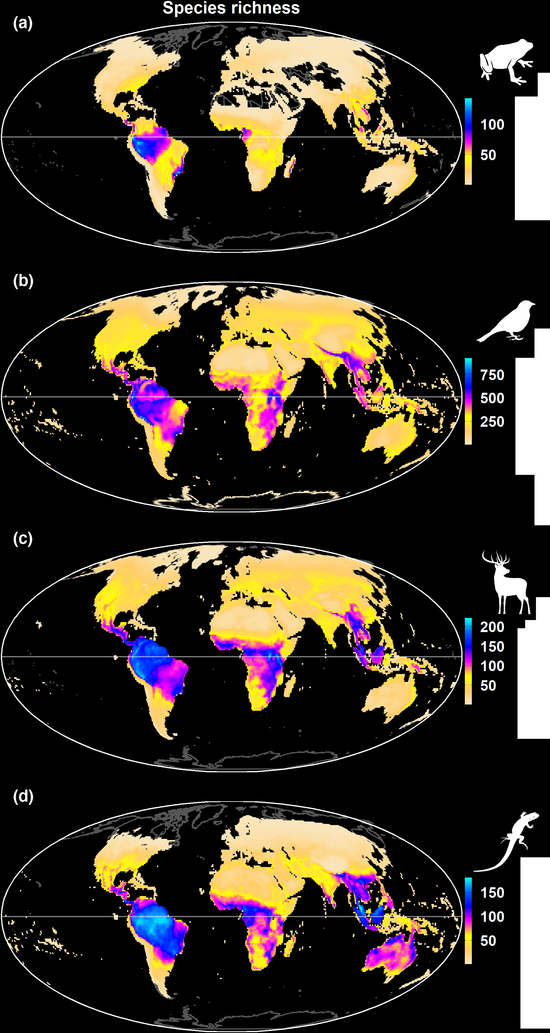
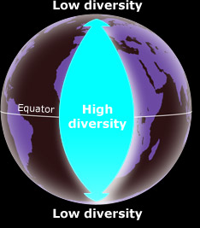
Diversity distribution patterns
Species are not distributed evenly across the world
Šmíd 2022, J Biogeo

Slide 3
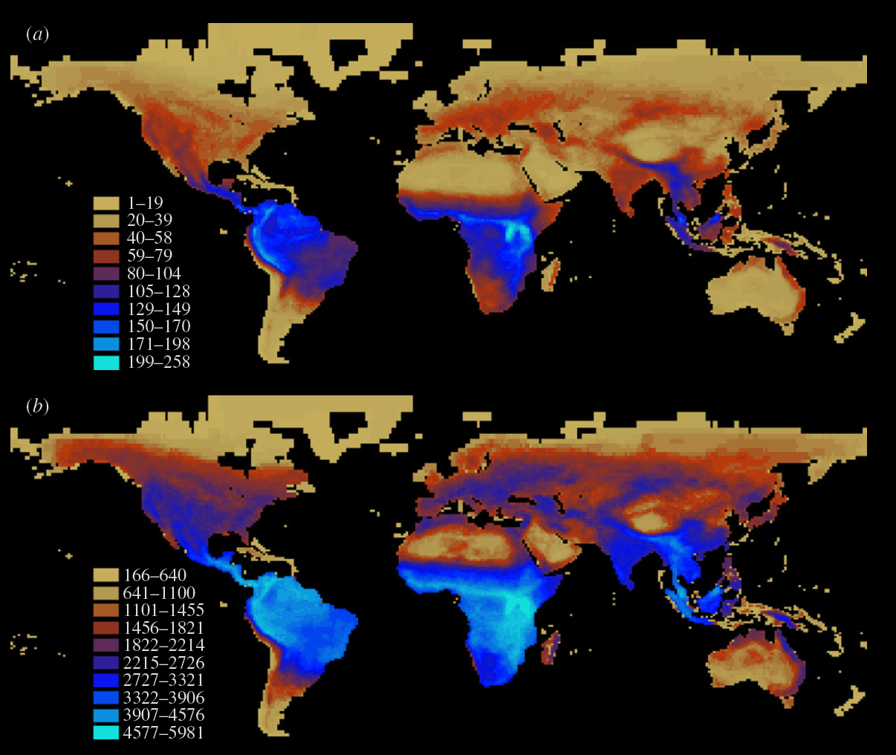
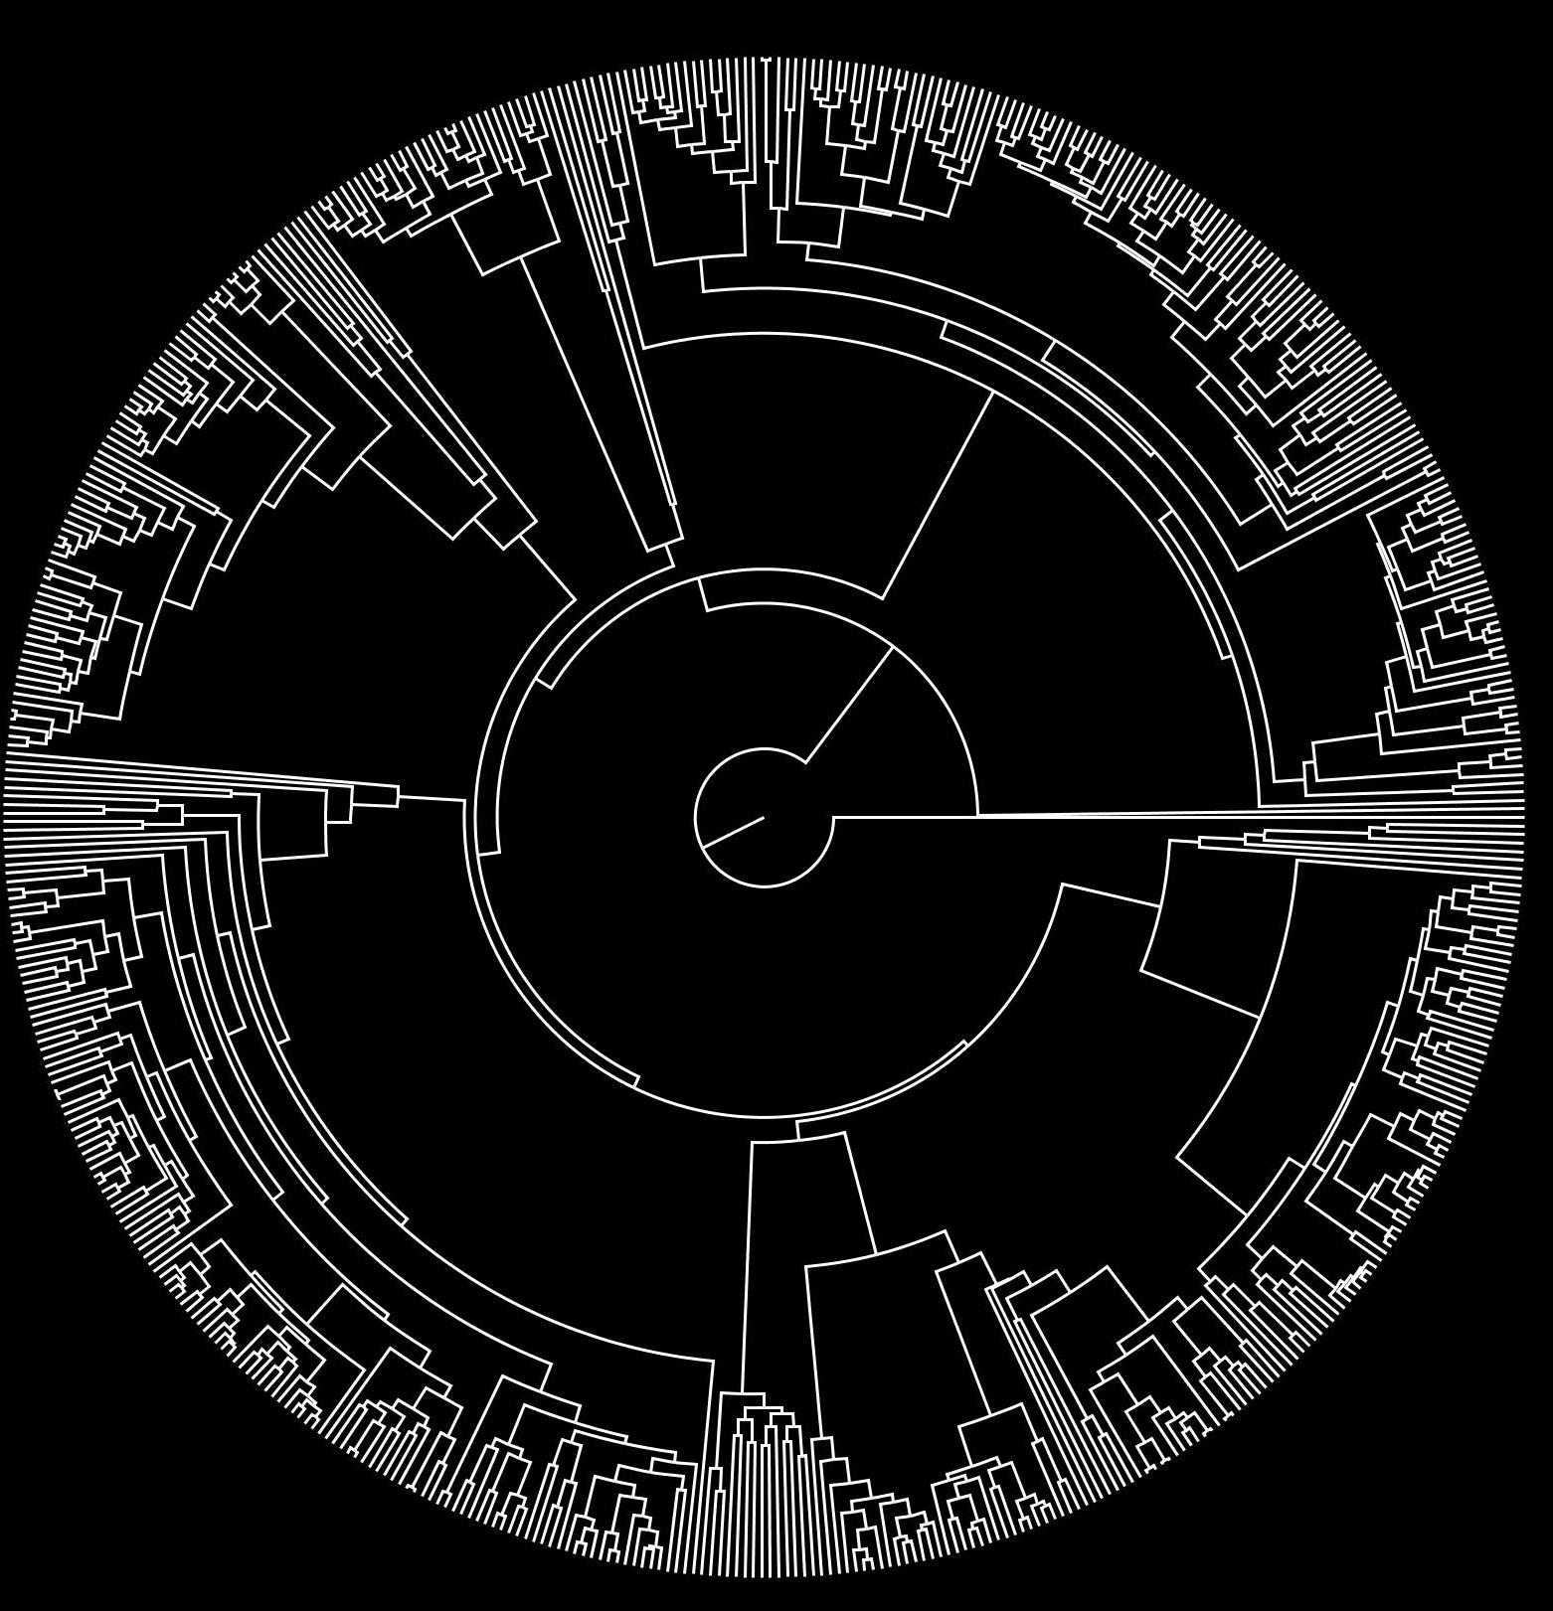
Phylogenetic diversity (PD)
Species richness
Phylogenetic relationships
+
Phylogenetic diversity (PD) (mammals)
Davies & Buckley 2011, Proc R Soc B

Slide 4
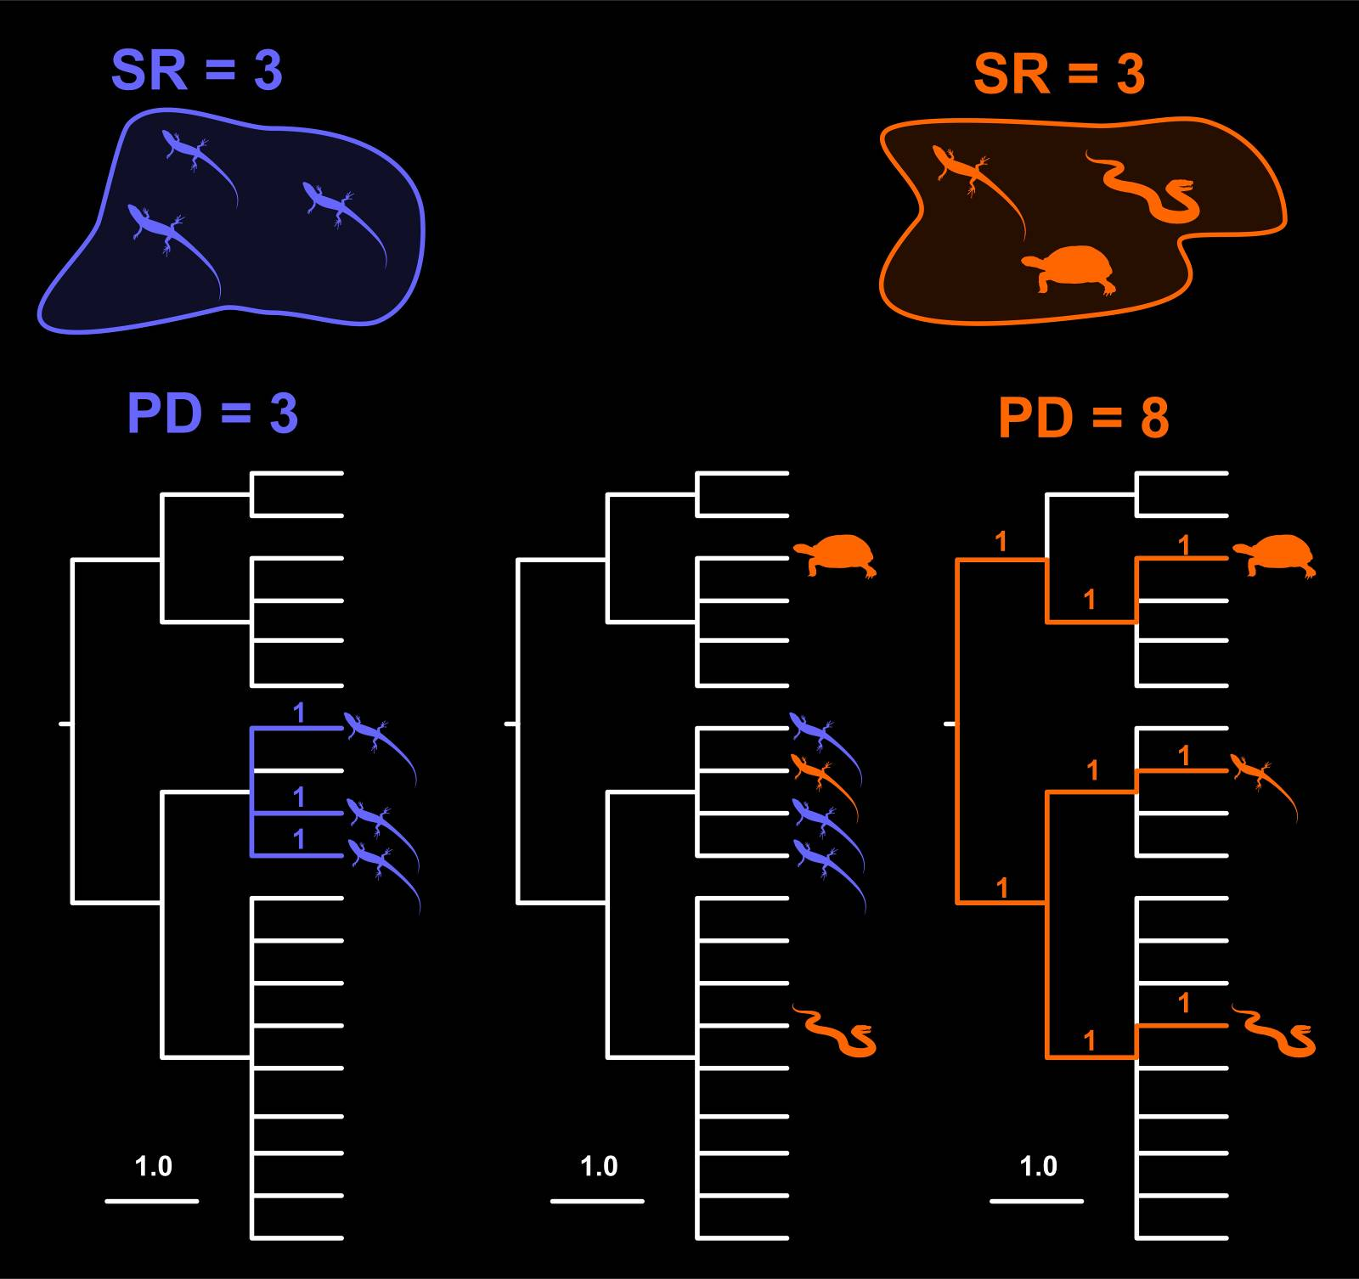
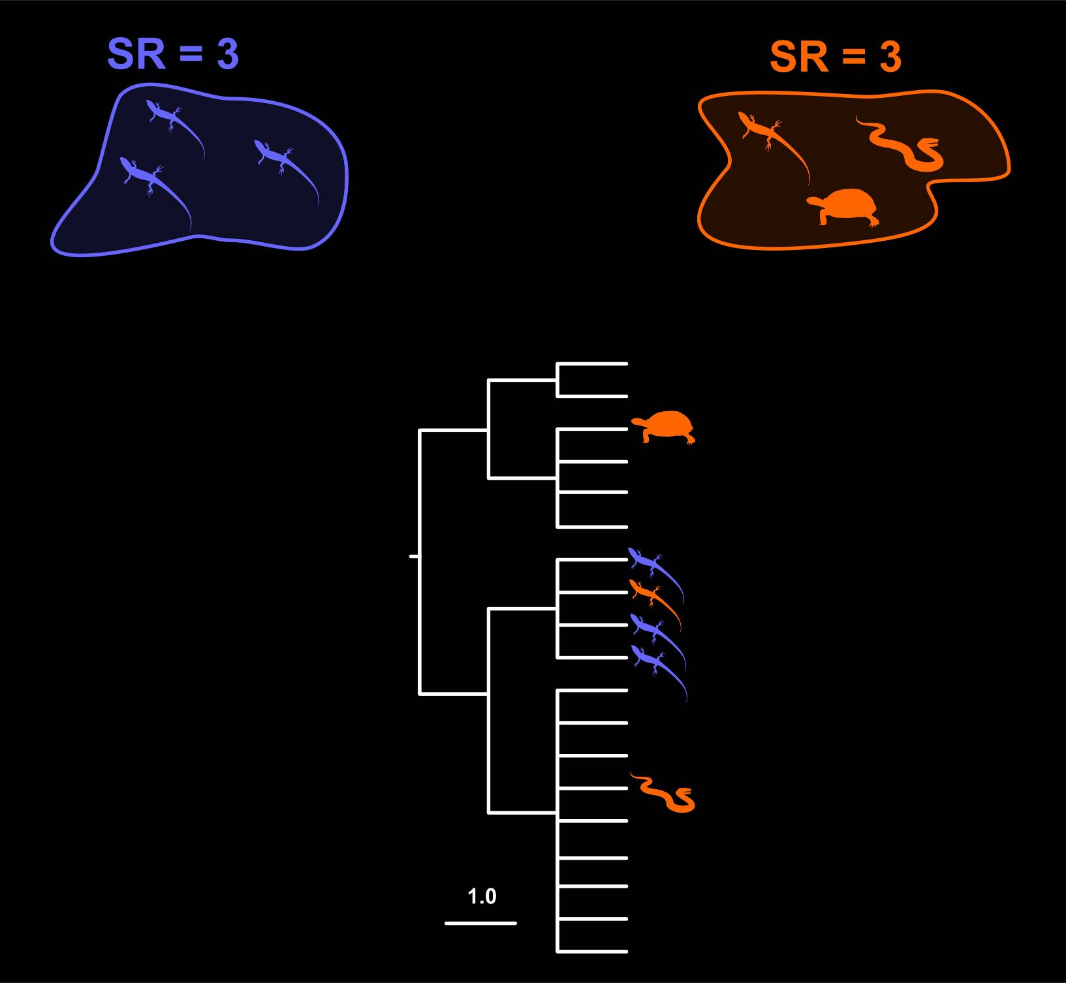
Phylogenetic diversity (PD)
Notes:
4

Slide 5
Phylogenetic diversity (PD)

Slide 6
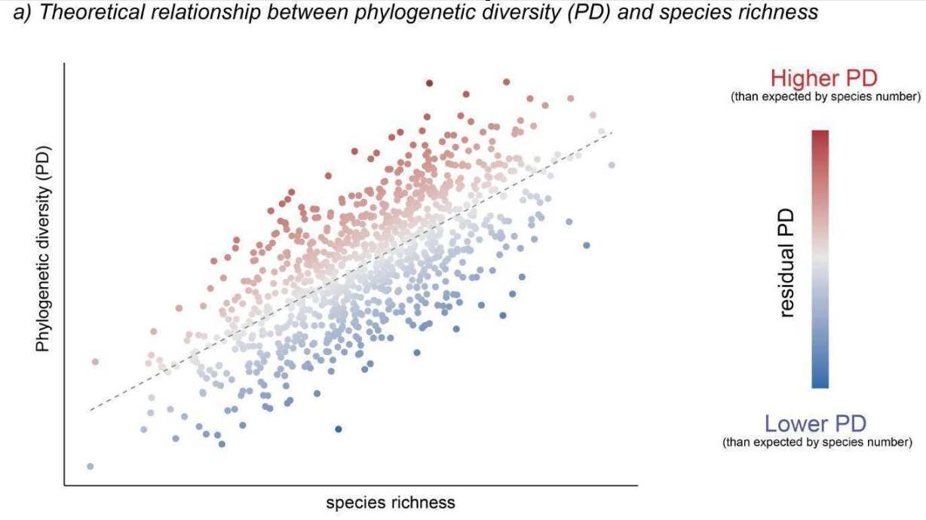
Phylogenetic diversity (PD)

Slide 7
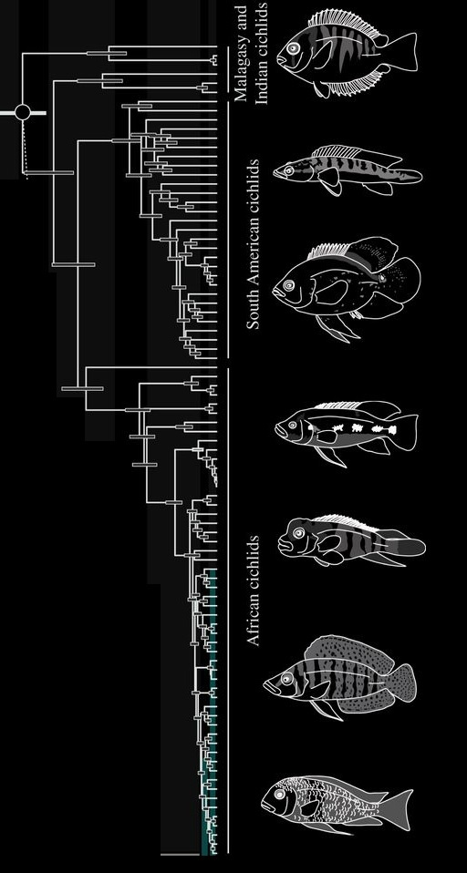
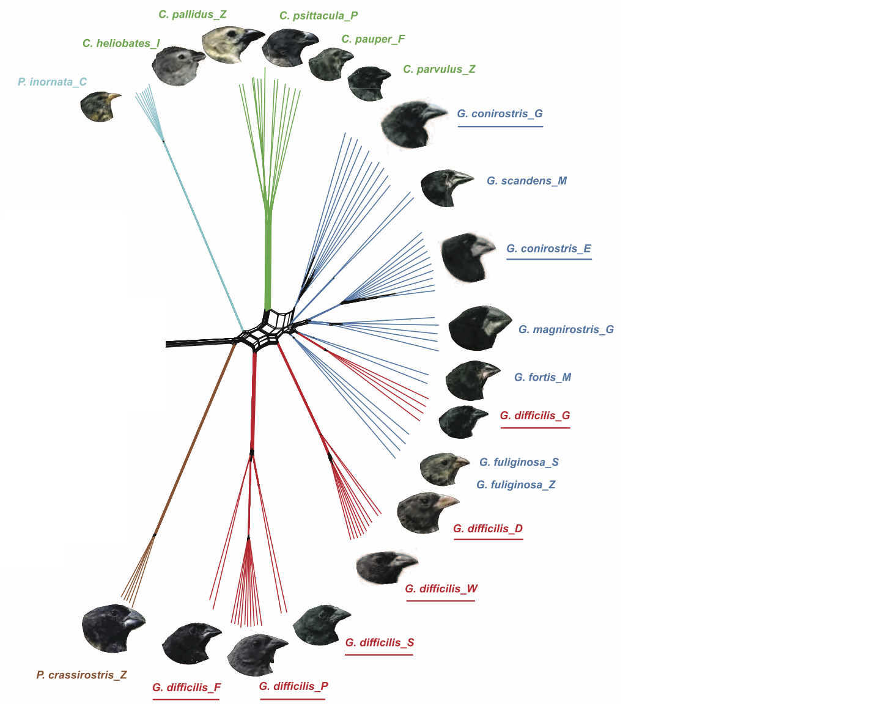
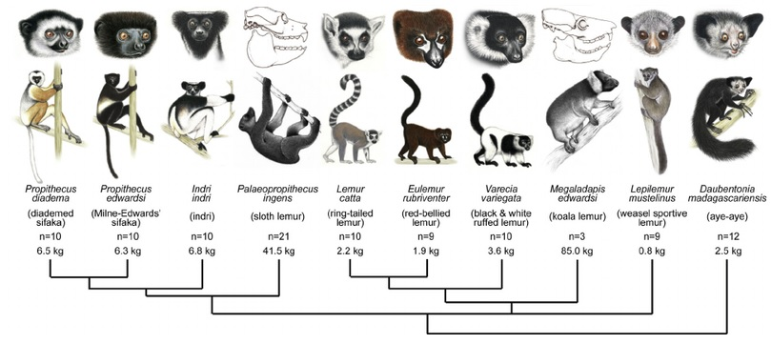
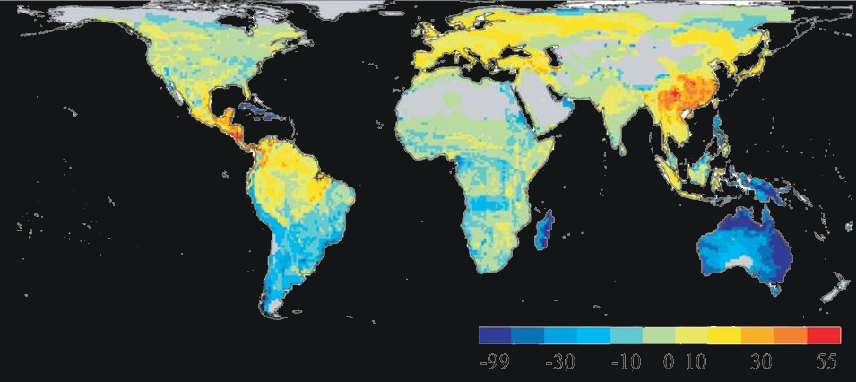
The blue zone
assemblages of closely related species
cradles of biodiversity
Friedman et al. 2013, Proc R Soc B
Fritz & Rahbek 2012, J Biogeo
Kistler et al. 2014, J Hum Evo

Slide 8
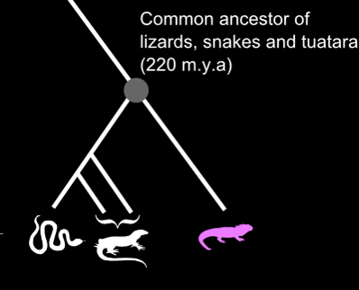
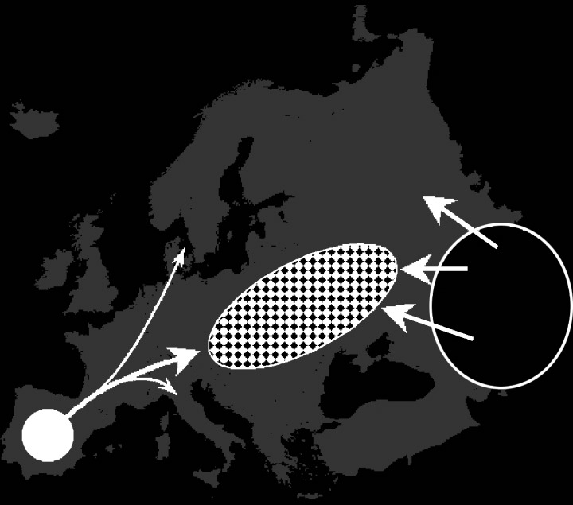
The red zone
assemblages of distantly related species
museums of biodiversity
Sharbel et al. 2001, Mol Ecol
Fritz & Rahbek 2012, J Biogeo

Slide 9
What processes are responsible for the distribution of the museums and cradles?

Slide 10
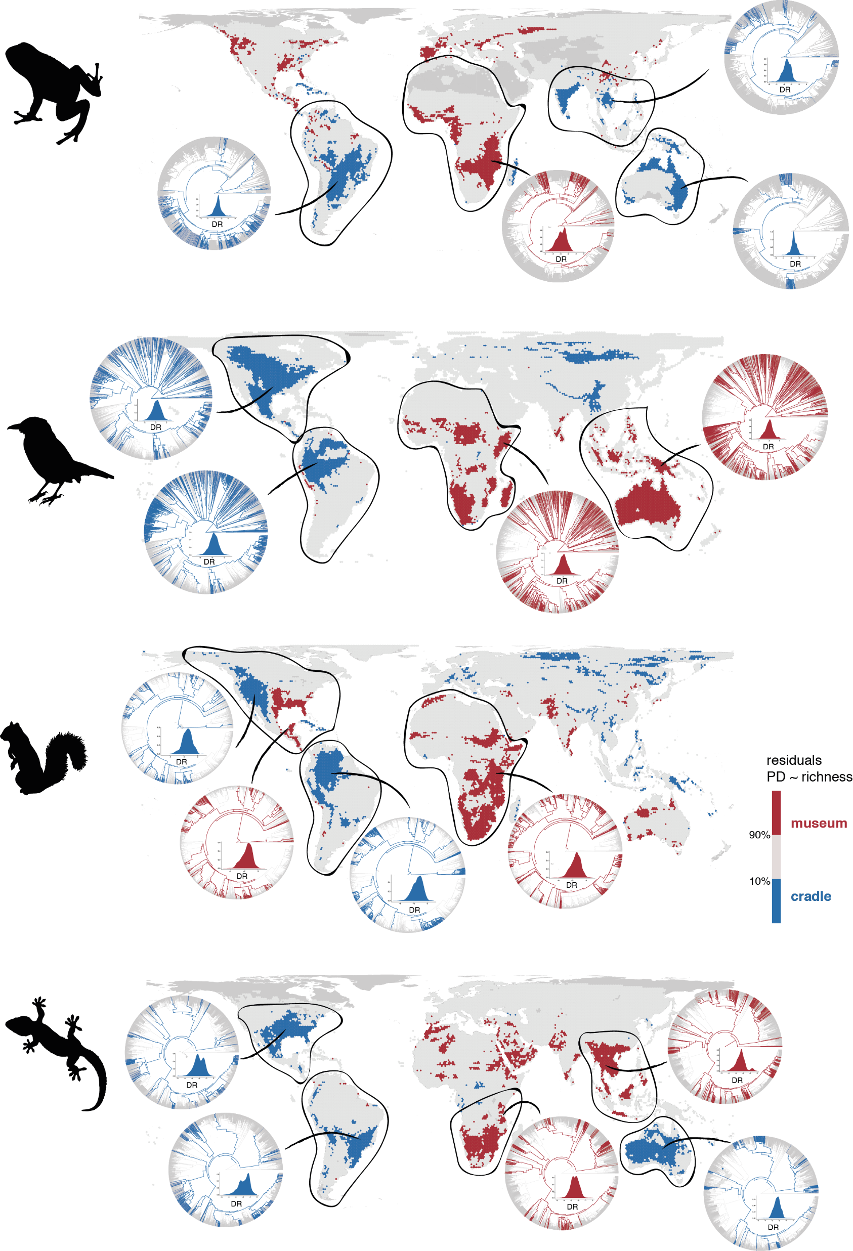
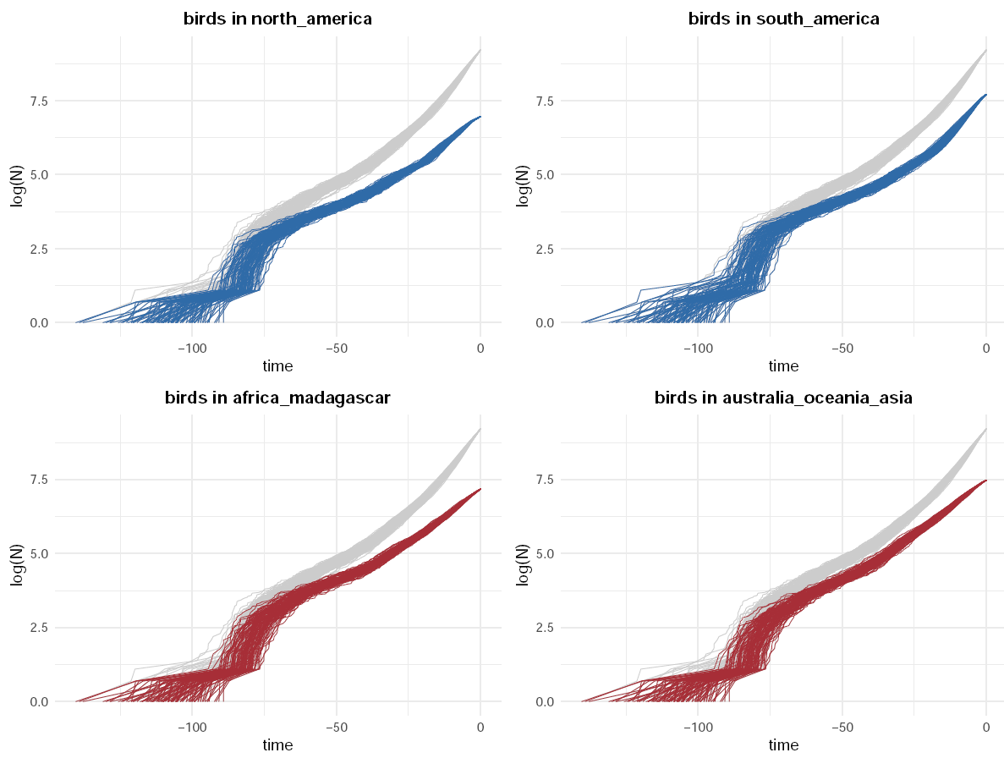
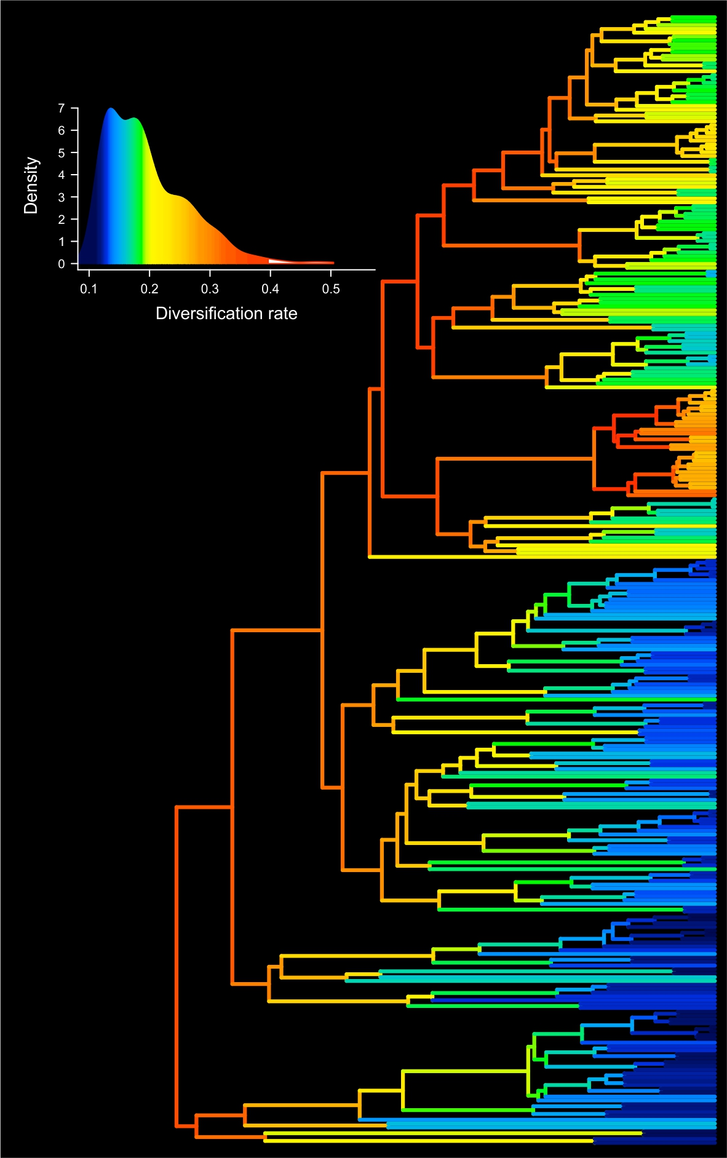
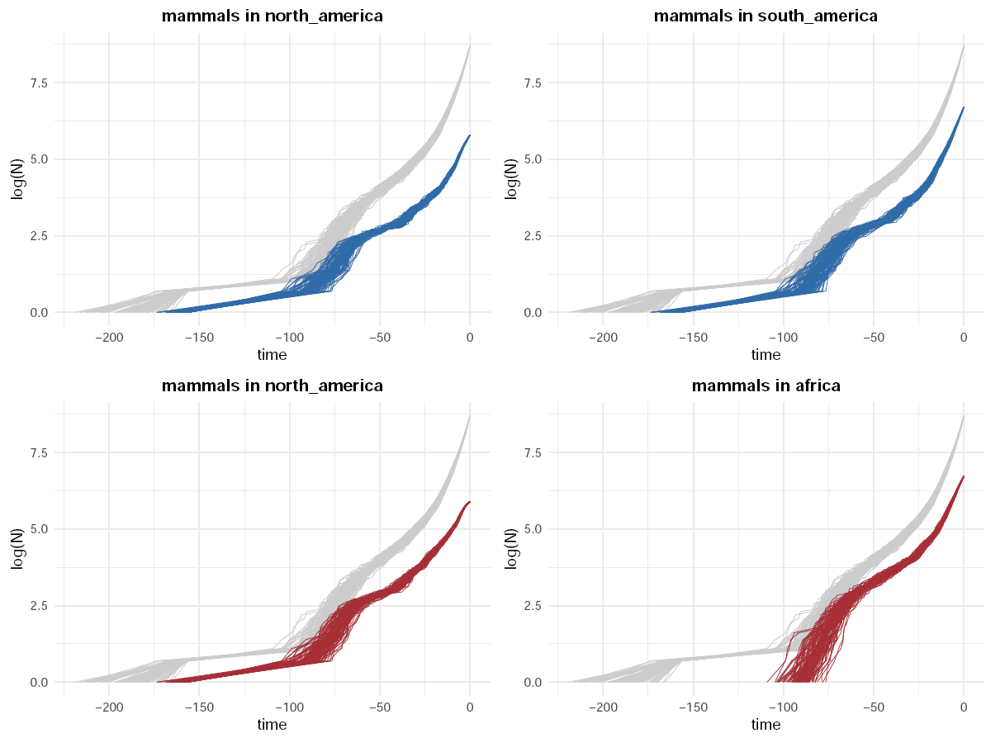
McGuire et al. 2014, Curr Biol
Tejero-Cicuéndez, Glob Ecol Biogeo, submitted
Notes:
10

Slide 11
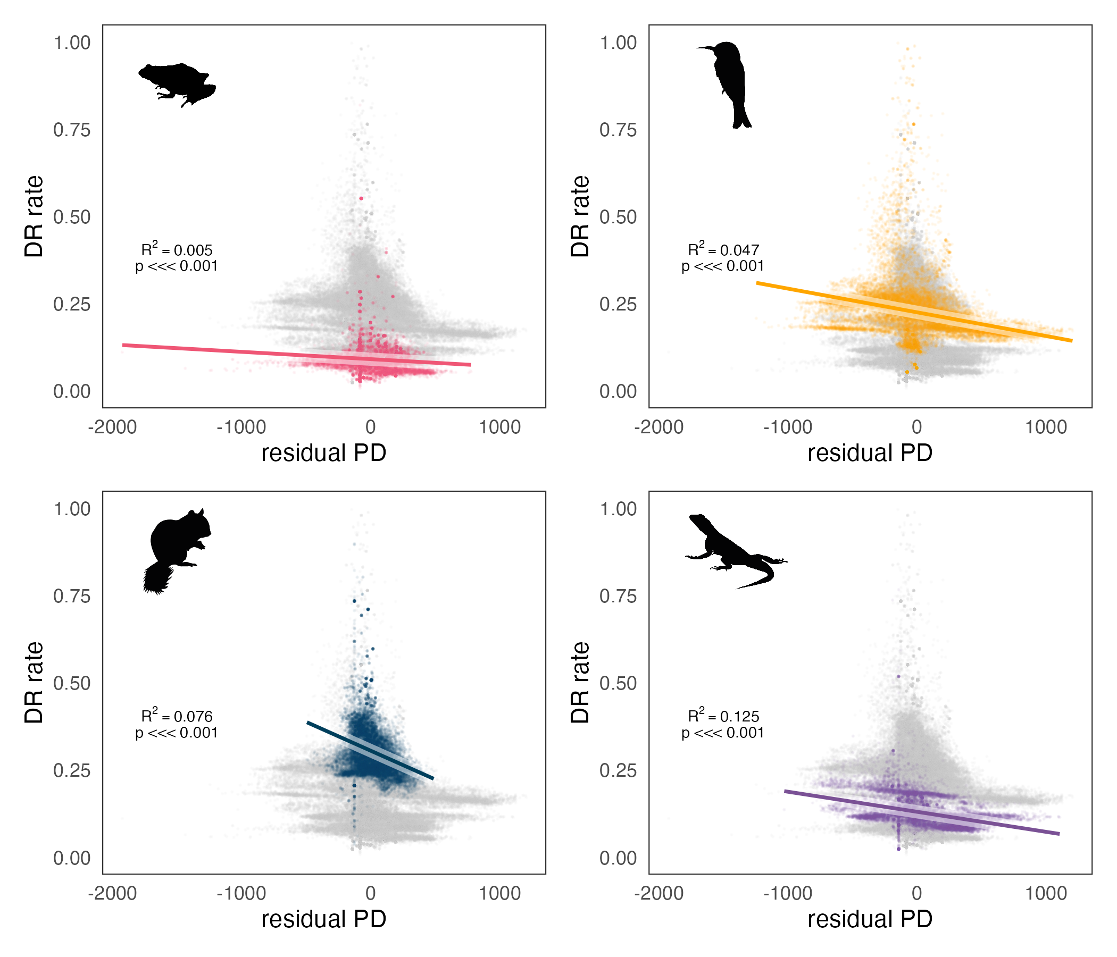
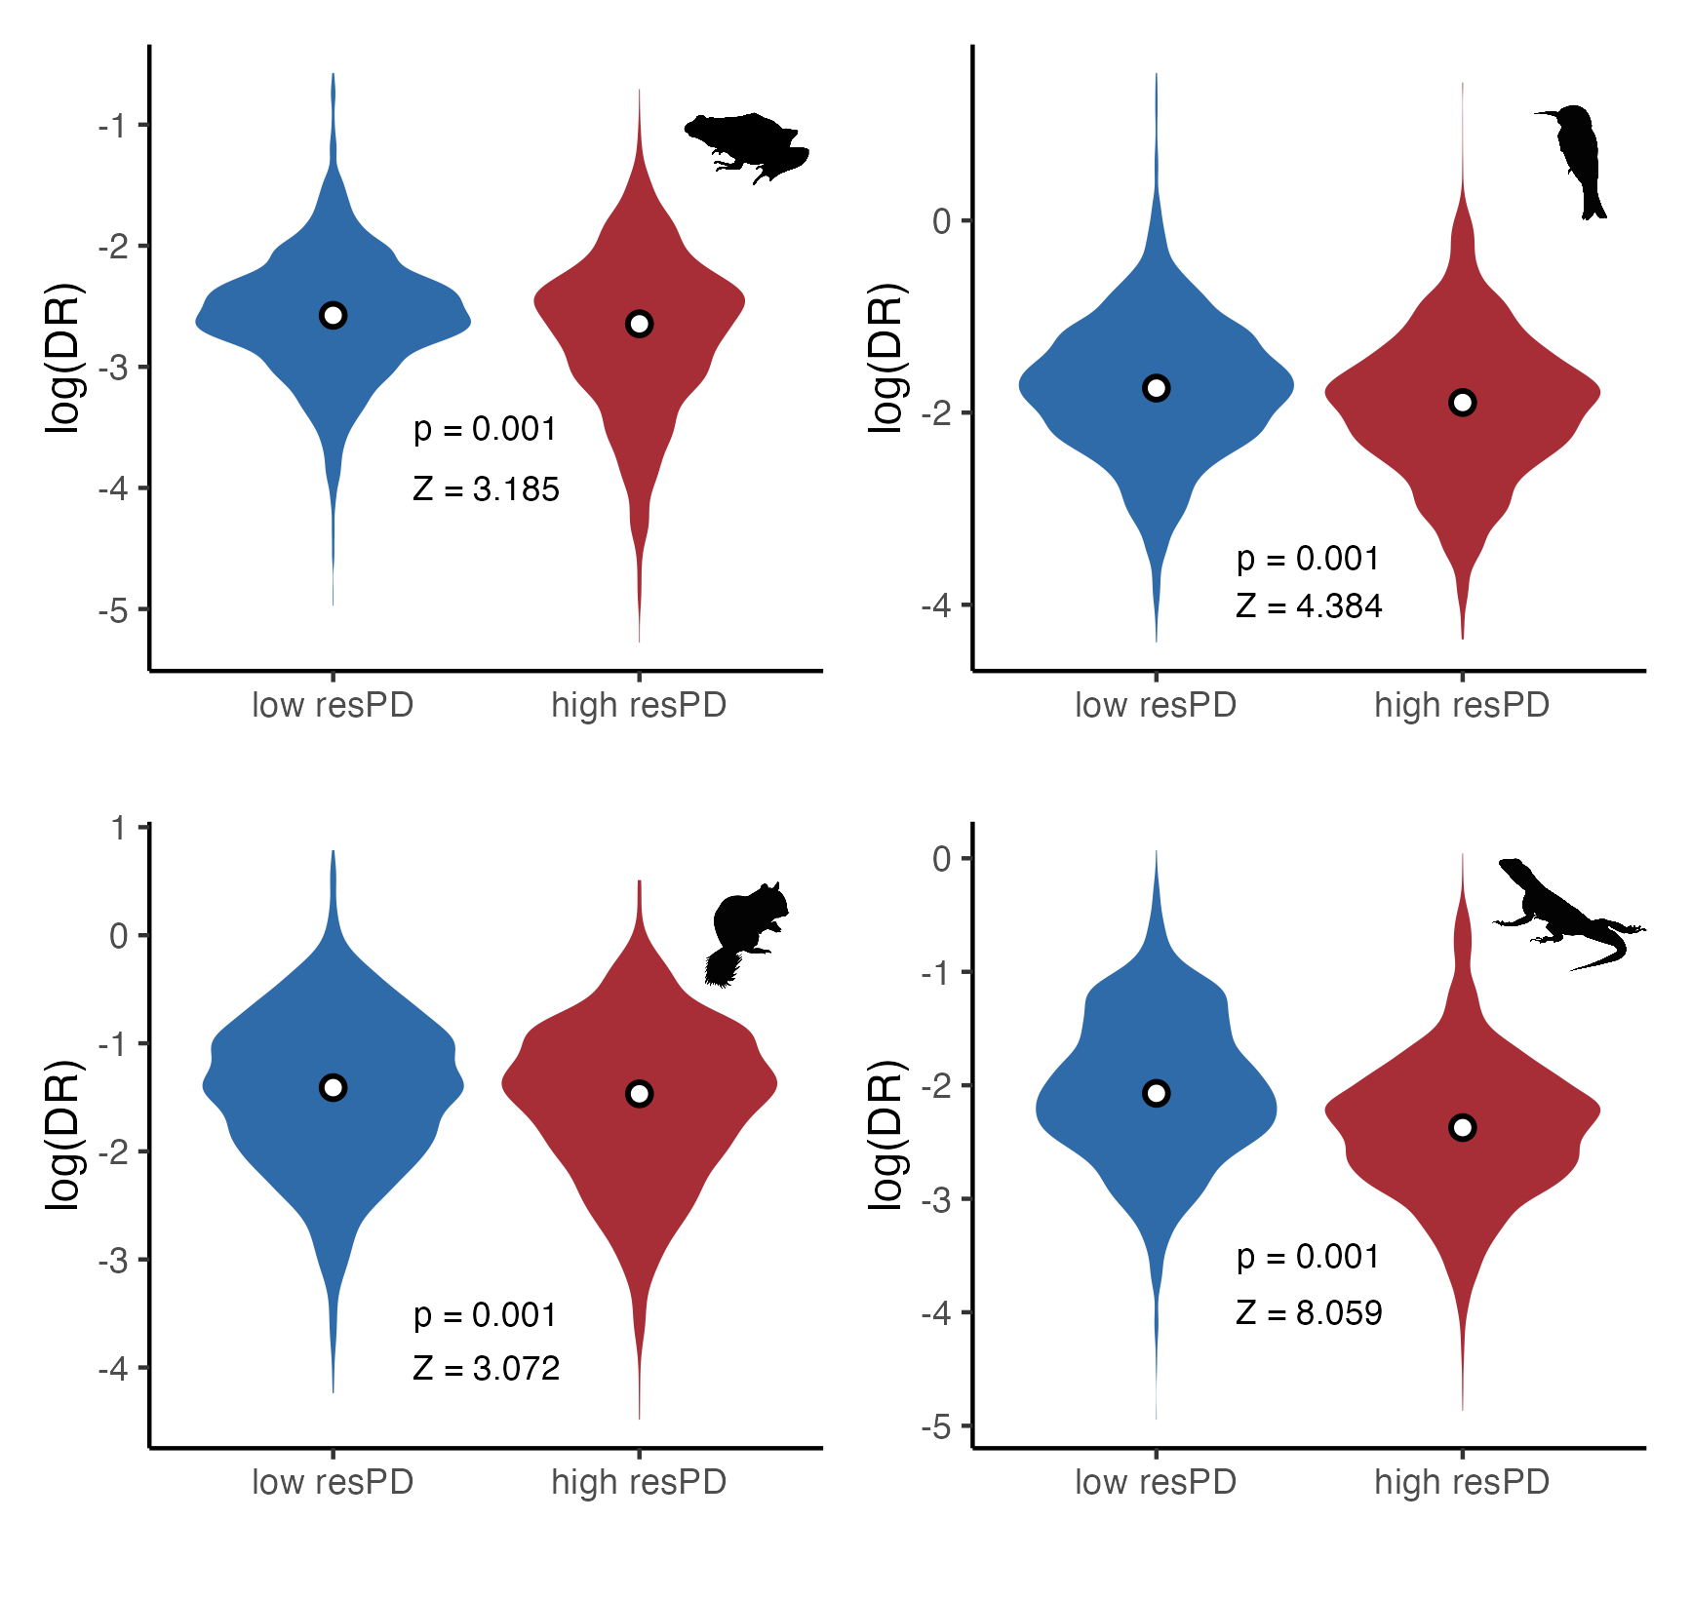
McGuire et al. 2014, Curr Biol
Tejero-Cicuéndez, Glob Ecol Biogeo, submitted
Notes:
11

Slide 12
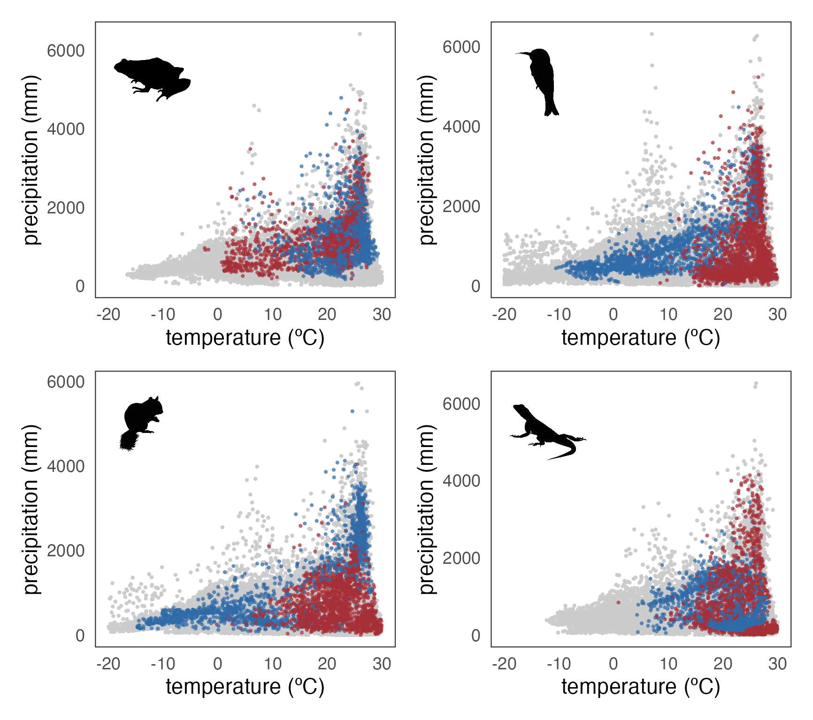
Tejero-Cicuéndez, Glob Ecol Biogeo, submitted
Notes:
12

Slide 13
Take home messages
Different distribution of cradles and museums across vertebrate clades
Notes:
13

Slide 14
Take home messages
Different distribution of cradles and museums across vertebrate clades
Recent speciation events helped generate present-day global biogeographic patterns

Slide 15
Take home messages
Different distribution of cradles and museums across vertebrate clades
Recent speciation events helped generate present-day global biogeographic patterns
Low to no effect of evolutionary time and climatic variables on the differentiation of regions

Slide 16
Thank you!

